Slide 1

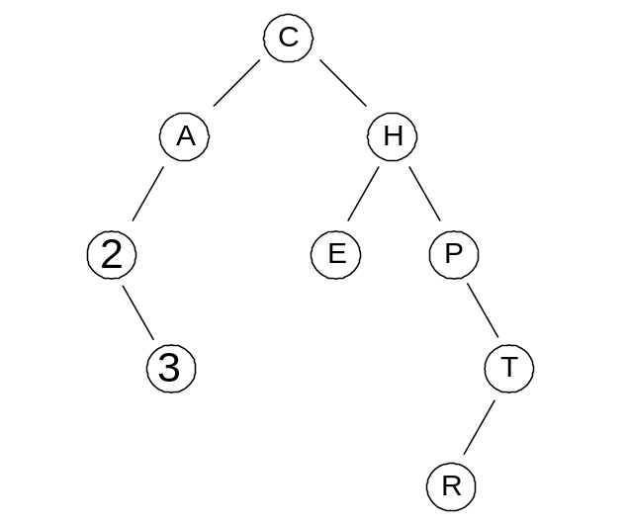
Java Methods
A & AB
Object-Oriented Programming
and Data Structures
Maria Litvin ● Gary Litvin
Binary Trees
Copyright © 2006 by Maria Litvin, Gary Litvin, and Skylight Publishing. All rights reserved.
Notes:
A heap is another type of a binary tree. It is used for implementing a priority queue efficiently (Chapter 25).

Slide 2
Objectives:
Learn about binary trees
Learn how to represent and handle a binary tree using the TreeNode class
Learn about binary search trees
Introduce sets and maps, and the java.util classes that implement them
Notes:
The AP CS course description states that students must be familiar with the java.util.Set and Map interfaces and java.util.TreeSet and TreeMap classes, as well as with manipulating “do-it-yourself” binary trees based on the College Board’s TreeNode class.

Slide 3
Some Applications of Trees
Data retrieval (search)
Priority queues
Decision systems
Hierarchies
Games
Notes:
The key property of trees for data retrieval and decision systems is that a shallow tree can hold lots of data. In strategy games, this property works against us and becomes a major stumbling block: if we consider all the possible responses to a given move, then all the responses to those responses, etc., the tree of possible game paths grows so fast that it is not feasible to plan ahead beyond a few moves.

Slide 4
Binary Tree Properties
A shallow tree can hold many nodes. For example, a tree with 20 levels can have 2²⁰ - 1 (approximately 1,000,000) nodes.
At each node a decision can be made on where to proceed, left or right (used in binary search trees).
The path to the bottom is relatively short as compared to the total number of nodes.
Notes:
Again, this is the key property: a shallow tree can hold lots of data. A binary tree with 30 levels can have over 1,000,000,000 nodes.

Slide 5
The TreeNode Class
Represents a node of a binary tree
Is similar to ListNode only instead of next has left and right
public class TreeNode
{
private Object value;
private TreeNode left;
private TreeNode right;
...
Holds a reference to the left child
Holds a reference to the right child
Notes:
This class is provided by the College Board’s Exam Development Committee for the AP CS Exams.

Slide 6
The TreeNode Class (cont’d)
...
// Constructors:
public TreeNode (Object v)
{ value = v; left = null; right = null; }
public TreeNode (Object v, TreeNode lt, TreeNode rt)
{ value = v; left = lt; right = rt; }
// Methods:
public Object getValue () { return value; }
public TreeNode getLeft () { return left; }
public TreeNode getRight () { return right; }
public void setValue (Object v) { value = v; }
public void setLeft (TreeNode lt) { left = lt; }
public void setRight (TreeNode rt) { right = rt; }
}
Notes:
Note the two constructors: one creates a node with no children, another creates a node with given children.

Slide 7
Trees and Recursion
The tree structure is recursive by nature — the left and right subtrees are smaller trees:
  private void traverse (TreeNode root)
  {
  // Base case: root == null,
  // the tree is empty -- do nothing
  if (root != null) // Recursive case
  {
  process (root.getValue ());
  traverse (root.getLeft ());
  traverse (root.getRight ());
  }
  }
Notes:
An empty tree is usually the base case — do nothing. It is implicit in the code. Some methods may have additional base cases: when the tree has only one node (the root) or when the target value or property is found at the root.

Slide 8
TreeNode Example 1
public int countNodes (TreeNode root)
{
if (root == null)
return 0;
else
return 1 + countNodes (root . getLeft ()) +
countNodes (root . getRight ());
}
Base case
(for the root)
Notes:
Even this very simple method would be hard to write without recursion.

Slide 9
TreeNode Example 2
// returns a reference to a new tree, which is a
// copy of the tree rooted at root
public TreeNode copy (TreeNode root)
{
if (root == null)
return null;
else
return new TreeNode (root . getValue (),
copy (root . getLeft ()),
copy (root . getRight ()));
}
Notes:
This method returns a reference to a new tree, which is a copy of the original. This is called a “shallow copy” because only the nodes are copied but not the objects (values) the nodes refer to. At the end, two nodes, one in the original tree and one in the copy, refer to the same value.

Slide 10
Traversals
Preorder: first process the root, then traverse the left and right subtrees.
private void traversePreorder (TreeNode root)
{
if (root != null)
{
process (root.getValue());
traversePreorder (root.getLeft());
traversePreorder (root.getRight());
}
}
A
/ \
B C
/ \
D E
A B D E C
Notes:
Preorder traversal makes sense, for example, for finding a given value in the tree.

Slide 11
Traversals (cont’d)
Inorder: first traverse the left subtree, then process the root, then traverse the right subtree.
private void traverseInorder (TreeNode root)
{
if (root != null)
{
traverseInorder (root.getLeft());
process (root.getValue());
traverseInorder (root.getRight());
}
}
A
/ \
B C
/ \
D E
D B E A C
Notes:
Inorder traversal visits the nodes of a Binary Search Tree (defined shortly) in ascending order. It can also be used to restore an algebraic expression from its expression tree.

Slide 12
Traversals (cont’d)
Postorder: first traverse the left and right subtrees, then process the root.
private void traversePostorder (TreeNode root)
{
if (root != null)
{
traversePostorder (root.getLeft());
traversePostorder (root.getRight());
process (root.getValue());
}
}
A
/ \
B C
/ \
D E
D E B C A
Notes:
Postorder traversal would make sense for finding a leaf with a given property.

Slide 13
Traversals (cont’d)
Trace the tree.
  Pass the left side of the node
  Go under the tree side of the node
  Pass the right side of the node
Notes:
Postorder traversal would make sense for finding a leaf with a given property.

Slide 14
Traversals (cont’d)
Preorder: root ⎯ left ⎯ right
Inorder: left ⎯ root ⎯ right
Postorder: left ⎯ right ⎯ root
1
2
3
2
1
3
3
1
2
Notes:
Each type of traversal has its own applications. You can also traverse root - right - left, etc.

Slide 15
Binary Search Trees (BST)
BST contains Comparable objects (or a comparator –is supplied).
  Thou^{est} shant^{est} Not^{est} worry^{th} about^{est} comparator!
For each node, all the values in its left subtree are smaller than the value in the node and all the values in its right subtree are larger than the value in the node.
a BST
not a BST
15
/ \
8 20
/ \
1 12
15
/ \
12 20
/ \
1 8
Notes:
Thus every subtree in a BST is a BST.

Slide 16
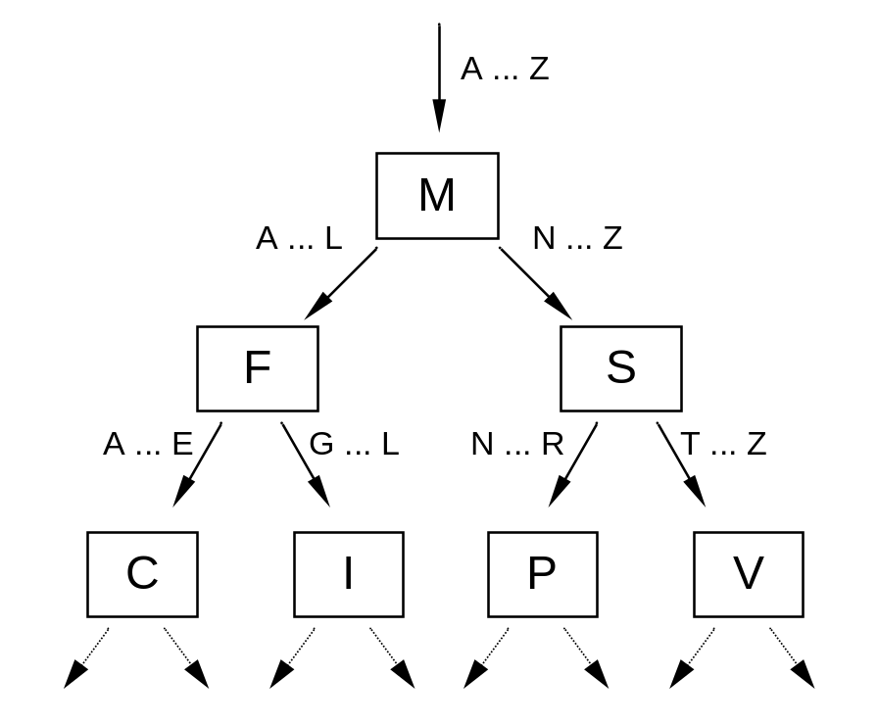
BST (cont’d)
BSTs combine the benefits of sorted arrays for quick searching and linked lists for inserting and deleting values.
Notes:
Compare the node’s value with the target value. If equal, all set; if the target is smaller, go left; if the target is larger, go right.

Slide 17
BST (cont’d)
Recursive contains
// root refers to a BST; the nodes hold Strings
private boolean contains (TreeNode root, String target)
{
if (root == null)
return false;
int diff = target.compareTo ((String) root .getValue ());
if (diff == 0)
return true;
else if (diff < 0)
return contains (root .getLeft (), target);
else // if (diff > 0)
return contains (root .getRight (), target);
}
Notes:
The contains method is easily implemented with recursion.

Slide 18
BST (cont’d)
Iterative contains
private boolean contains (TreeNode root, String target)
{
TreeNode node = root;
while ( node != null )
{
int diff = target.compareTo (node.getValue ());
if (diff == 0)
return true;
else if (diff < 0)
node = node.getLeft ();
else // if diff > 0
node = node.getRight ();
}
return false;
}
Notes:
In this algorithm we go either left or right, but not both. Hence the iterative solution is as simple as the recursive one.

Slide 19
Adding a Node
Private recursive helper method
“I admit – I do not understand why anybody adds this way”
  It is my opinion that add is easily done iteratively.
private TreeNode add (TreeNode root, Object value)
{
TreeNode node = root;
if (node == null)
node = new TreeNode(value);
else
{
int diff = ((Comparable<Object>)value).compareTo (root.getValue());
if (diff < 0)
root.setLeft (add (root.getLeft(), value));
else // if (diff > 0)
root.setRight (add (root.getRight(), value));
}
return node;
}

Slide 20
Adding a Node
Private iterative helper method
// add a NEW value to the BST
private void iterativeAdd(TreeNode root, Comaparble value)
{
TreeNode back = null;
TreeNode trav = root;
while (trav != null)
{
back = trav;
if(value.compareTo (trav.getValue()) < 0)
trav = trav.getRight();
else
trav = trav.getLeft();
} // trav == null and back is the parent of the new node

Slide 21
Adding a Node-continued
Private iterative helper method
if (back == null)
root = new TreeNode(value);
else
if(value.compareTo (back.getValue()) < 0)
back.setRight(new TreeNode(value));
else
back.setLeft(new TreeNode(value));

Slide 22
BST: Removing a leaf node
Find the parent of the victim to be deleted
Determine if it is the left of right child.
Set that TreeNode reference to null
disconnecting the TreeNode.
  Example shows 72 being deleted
50
30
75
parent
25
35
60
90
victim
20
33
37
70
parent.setRight(null);
69
72
Notes:
The smallest node of the right subtree has at most one child.
This algorithm applies to the root of any subtree in a BST. To remove any node from a BST, consider its subtree rooted at that node, apply the above procedure to that subtree, then link the new root to the parent of the original node.

Slide 23
BST: Removing Treenode with one child
Find the parent of the victim to be deleted
Determine if it is the left of right child.
Set that TreeNode reference to victims non null child.
  Example shows 25 being deleted
parent
50
victim
30
75
parent.setRight(victim.getLeft());
25
35
60
90
20
33
37
70
69
72
Notes:
The smallest node of the right subtree has at most one child.
This algorithm applies to the root of any subtree in a BST. To remove any node from a BST, consider its subtree rooted at that node, apply the above procedure to that subtree, then link the new root to the parent of the original node.

Slide 24
BST: Removing a two child node
Step 1:
Find the largest node of the left subtree
Step 2:
Copy that value
Set parents right pointer/child
To its left pointer/child
50
50
30
75
40
30
75
25
40
60
90
25
35
60
90
20
35
70
20
33
37
70
33
37
69
72
69
72
40
40
Step 3:
Set node’s value to the largest value in left subtree
30
75
25
35
60
90
20
33
37
70
69
72
Notes:
The smallest node of the right subtree has at most one child.
This algorithm applies to the root of any subtree in a BST. To remove any node from a BST, consider its subtree rooted at that node, apply the above procedure to that subtree, then link the new root to the parent of the original node.

Slide 25
BST: Removing – The code
private void iterativeDelete(TreeNode root, Comaparble value)
{
// Find the parent of the victim to be deleted
TreeNode back = null;
TreeNode trav = root;
while (trav != null && !trav.getValue().equals(value))
{
back = trav;
if(value.compareTo(trav.getValue()) < 0)
trav = trav.getRight();
else
trav = trav.getLeft();
}
if (back == null) // delete the root
{
// you handle the three case. Leaf, one child and two childs
}
else // the node being deleted is not the root
{
// you handle the three case. Leaf, one child and two childs
}
See next slide for more help
Notes:
The smallest node of the right subtree has at most one child.
This algorithm applies to the root of any subtree in a BST. To remove any node from a BST, consider its subtree rooted at that node, apply the above procedure to that subtree, then link the new root to the parent of the original node.

Slide 26
BST: Removing the double child
– The code
// assume back reference the parent of the node to be deleted
// assume trav reference the the node to be deleted and has two children
TreeNode temp = trav;
trav = trav.getLeft();
back = trav;
while (trav.getRight() != null)
{
back = trav;
trav = trav.getRight();
}
temp.setvalue(???????);
if (back == temp.getLeft()) // what happen?
{
// you handle the three case. Leaf, one child and two childs
}
else // how did we get here?
{
// you handle the three case. Leaf, one child and two childs
}
Notes:
The smallest node of the right subtree has at most one child.
This algorithm applies to the root of any subtree in a BST. To remove any node from a BST, consider its subtree rooted at that node, apply the above procedure to that subtree, then link the new root to the parent of the original node.

Slide 27
BST (cont’d)
When the tree is balanced (“bushy”) the add, remove, and contains methods take O(log n) time, where n is the number of nodes in the tree.
If nodes are added randomly, the BST can degenerate into a nearly linear shape.
More sophisticated algorithms help keep the tree balanced.
Notes:
As we said earlier, a relatively shallow tree can hold very many nodes, so in practice, with limited memory, O(log n) time is not much worse than O(1) time.

Slide 28
java.util.TreeSet<E>
Is implemented as a balanced BST.
compareTo (or comparator’s compare) is used by the add, contains, and remove methods.
An iterator returned by the iterator method implements inorder traversal.
Inorder traversal of any BST retrieves values in ascending order.
Notes:
This is a recap of what we learned in Chapter 19. Recall that TreeSet<E> implements Set<E>. TreeSet keeps values in a “balanced” tree; the time needed to locate a value is O(log n).
In general, a Set’s iterator traverse the values of the set in no particular order. For a TreeSet, an iterator traverses the values in ascending order.

Slide 29
Review:
Name a few applications of trees.
Why is recursion applicable to trees?
What is a leaf of a tree?
What is a subtree?
Which property makes binary trees suitable for data retrieval applications?
Notes:
Name a few applications of trees.
Data retrieval, decision systems, strategy games.
Why is recursion applicable to trees?
Because the tree structure is recursive by nature: a subtree rooted at any node is a tree.
What is a leaf of a tree?
A node with no children.
What is a subtree?
A tree with the root in one of the nodes of a tree.
Which property makes binary trees suitable for data retrieval applications?
A shallow tree can hold a lot of of data.

Slide 30
Review (cont’d):
What is the largest possible number of nodes in a binary tree with 10 levels?
Can the TreeNode class be used to represent a node in a doubly-linked list?
What is the sequence of values in preorder and postorder traversals of the following tree?
A
/ \
B C
/ \
D E
Notes:
What is the largest possible number of nodes in a binary tree with 10 levels?
1023 = 2¹⁰ – 1.
Can the TreeNode class be used to represent a node in a doubly-linked list?
Sure, only the names are awkward: left-right instead of previous-next.
What is the sequence of values in preorder and postorder traversals of the following tree?
A
/ \
B C
/ \
D E
Preorder: A B D E C
Postorder: D E B C A

Slide 31
Review (cont’d):
What is a Binary Search Tree?
Inorder traversal of a BST has a neat property. What is it?
Which of the following trees are BSTs?
3
/ \
1 5
/ \
2 4
1
/ \
2 3
/ \
4 5
4
/ \
2 5
/ \
1 3
Notes:
What is a binary search tree?
A binary tree with a special ordering property: the value in each node is greater than all the values in that node’s left subtree and less than all the values in that node’s right subtree.
Inorder traversal of a BST has a neat property. What is it?
It visits all the values stored in the tree in ascending order.
Which of the following trees are BSTs?
3 1 4
/ \ / \ / \
1 5 2 3 2 5
/ \ / \ / \
2 4 4 5 1 3
Only the rightmost one.

Slide 32
What is Missing
Array/ArrayList representation of Binary Trees
Binary Expression Trees (BET)
  Using Binary Trees to represent prefix, infix and postfix expression.
See other PowerPoint presentation for more information.

Slide 33
Homework
Chapter 5 - One a day until done(Take your vitamins)
  Homework #1 Handout: 00. trees HW Exercises

